Slide 1

BROOKSOURCE & TECHNICAL YOUTH
CAPITAL UNIVERSITY 9/17/2018

Slide 2
AGENDA
What is Brooksource & Technical Youth?
How to work with Recruiters
Types of employment
Career paths in IT
Roles we are hiring for

Slide 3


WHO ARE WE?
KAITLYN THOMPSON Team Lead, Professional Recruiter
kthompson@brooksource.com
MEGAN ECKERLE Technical Youth Coordinator
meckerle@brooksource.com

Slide 4









WHAT IS BROOKSOURCE?
We are an IT Recruiting company founded in 2000. We have 25 markets nationwide! We recruit on all different types of technical positions ranging from entry level to C-level executive roles!
Our Technical Youth program is designed to help students with the transition into the professional world. We provide additional technical training and professional development to start your career!

Slide 5





Slide 6
HOW TO WORK WITH RECRUITERS
WHAT DO WE DO?????
We hire on behalf of clients
We thoroughly screen candidates and help match you to job opportunities
Recruiting process: Phone Screen, Face to Face Meeting, Reference Check, Client Interview, Serve as Point of Contact During Employment
DO THEY CHARGE FEES?
NO!!! We are not headhunters and never charge you anything! It’s FREE to work with Brooksource!
I DON’T GRADUATE FOR A WHILE….HOW CAN I WORK WITH YOU NOW?
Career guidance and market insight
Resume reviews
Mock interviews
Networking

Slide 7
GOOD QUESTIONS TO ASK RECRUITERS
Always specify that they require your permission to submit your resume to a client
Know where your resume has been sent
Thoroughly understand the position you are being submitted for, know the pay, understand the terms of agreement
Know the reputation of the company you are working with
When possible, find a company tailored to your specific interest

Slide 8
TYPES OF EMPLOYMENT
CONTRACT
Expected employment for a certain period of time, possibility for extension
CONTRACT-TO-HIRE
Employment on a contractual basis for a certain period of time, expectation of becoming a permanent employee of the client

Slide 9
CAREERS IN TECHNOLOGY
Software engineering
Project management
Business Analysis
Quality Assurance + software testing
Infrastructure support
Data analysis

Slide 10
SOFTWARE ENGINEERING
Requirements: foundational programming, database knowledge, Analytical skills
Hot Technologies: JavaScript, Swift, Python, Java, Ruby, R
Companies look for: GitHub, Stack Overflow, Lynda.com, coursera, published projects, website

Slide 11
BUSINESS ANALYST
Requirements: SDLC, Programming, prototyping
Hot Technologies: Jira, user stories, agile
Companies look for: Keeps up on tech trends, explanation of workflow, business acumen, ability to communicate, writing ability

Slide 12
QUALITY ASSURANCE & TESTING
Requirements: SDLC, Programming fundamentals, code testing
Hot Technologies: selenium, Appium, hp quicktest, regression testing
Companies look for: interest in breaking & fixing, documentation skills, initiative, interest in automation

Slide 13
DATA ANALYSIS
Requirements: sql, python, Excel
Hot Technologies: NoSQL databases, predictive analytics, r, data virtualization, APIs, data integration, Hadoop
Companies look for: database knowledge, cloud initiatives, scripting

Slide 14
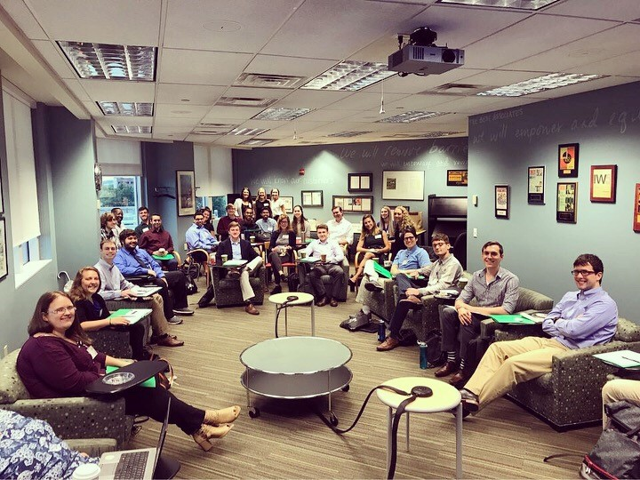
WE’RE HIRING!!!
Huntington Bank
Located in Easton
Starting the interview process in the next few weeks, offers will be extended by November
Positions will start in January
Roles include:
Business Systems Analyst
Data Analyst
Risk Testers
QA Analyst
Programmer Analyst (software engineer)
Project Coordinator

Slide 15

I WANT BROOKSOURCE’S HELP!
Add us on LinkedIn!
Take a business card
Send us your resume
Schedule a conversation with Megan or Kaitlyn so we can start helping you prepare for your job search!
MEGAN ECKERLE
614-456-3100
meckerle@brooksource.com
KAITLYN THOMPSON
614-360-1409
kthompson@brooksource.com

